Slide 1



Slide 2
PROBLEMS
The person who goes to random places doesn’t know where to go and what to do. Also they have missed a lot of things that they must have done.
Our main focus is Pakistan, as there is no website or application working particularly for Pakistan or providing all the needs of tourists in Pakistan.
Travelling is one of the hobbies which is growing day by day but in our country, there are a lot of services which aren’t provided on internet or the people are not aware of them.

Slide 3
First our country, all the services and locations available in our country that google is not showing, making people aware of them will be the first priority.
SOLUTION
Destinations or nearby attractions will be available for everyone using the application and also events like live concerts etc. will be also updated for the tourists.
Website will be available for pc or laptop users and will provide them all facilities that we are giving in their desired devices.

Slide 4









CONTRIBUTERS
And many more …….

Slide 5
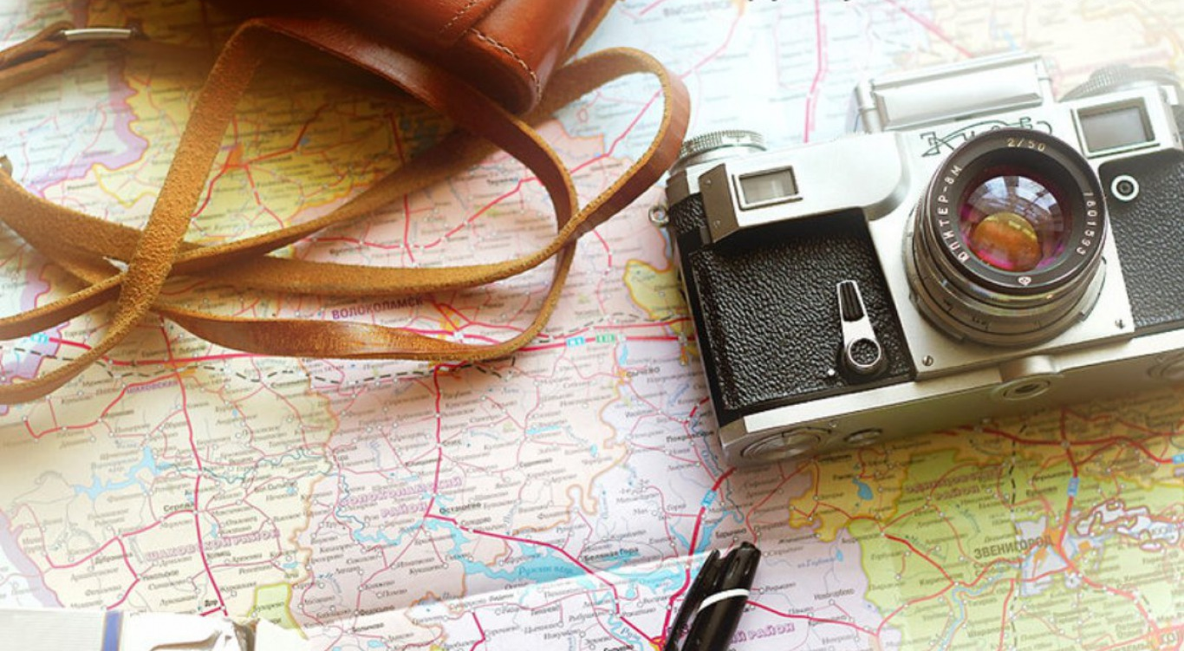
Features-
What we provide?
TravellingDiaries will work for the destinations all around the globe. The attractive man-made and natural places of continents, countries and cities will be available to be discovered.
It will cover hotels, resorts & restaurants all around the world. If you're looking for restaurants nearby or thinking where to order online then TD will always help you.
Timings, distance, routes and stops of Aero planes, Trains, buses and other means of transport all information about them, you can just get it on TD.
Different packages of travels and tours will be available on TD. It includes food, visit to places, means of transportation, route planning and other entertainments along the route.
The user which has logged in can upload videos, images or in other words user can BLOG or VLOG. The uploaded material by the user can be seen in people’s section where users can take more information about places.
More means of entertainment will be uploaded as events on TravellingDiaries Live concerts, music shows, theaters and other means of entertainment going nearby will be notified by the app.
And last but not the least the people can also get nearby first-aid centers or hospitals in need of an emergency

Slide 6

Competitive Advantage-
Why are we better?
We will allow user to give comments & write blogs or share/upload videos and images.
Another option is that user can inform us about places that he or she has seen but not us then the information of that place will also be available to that user.
As with the Blogs, users can also make the Vlogs and share with other users their experience of visiting some place.
User can also be updated about other means of entertainment like live concerts, events, exhibition etc.

Slide 7
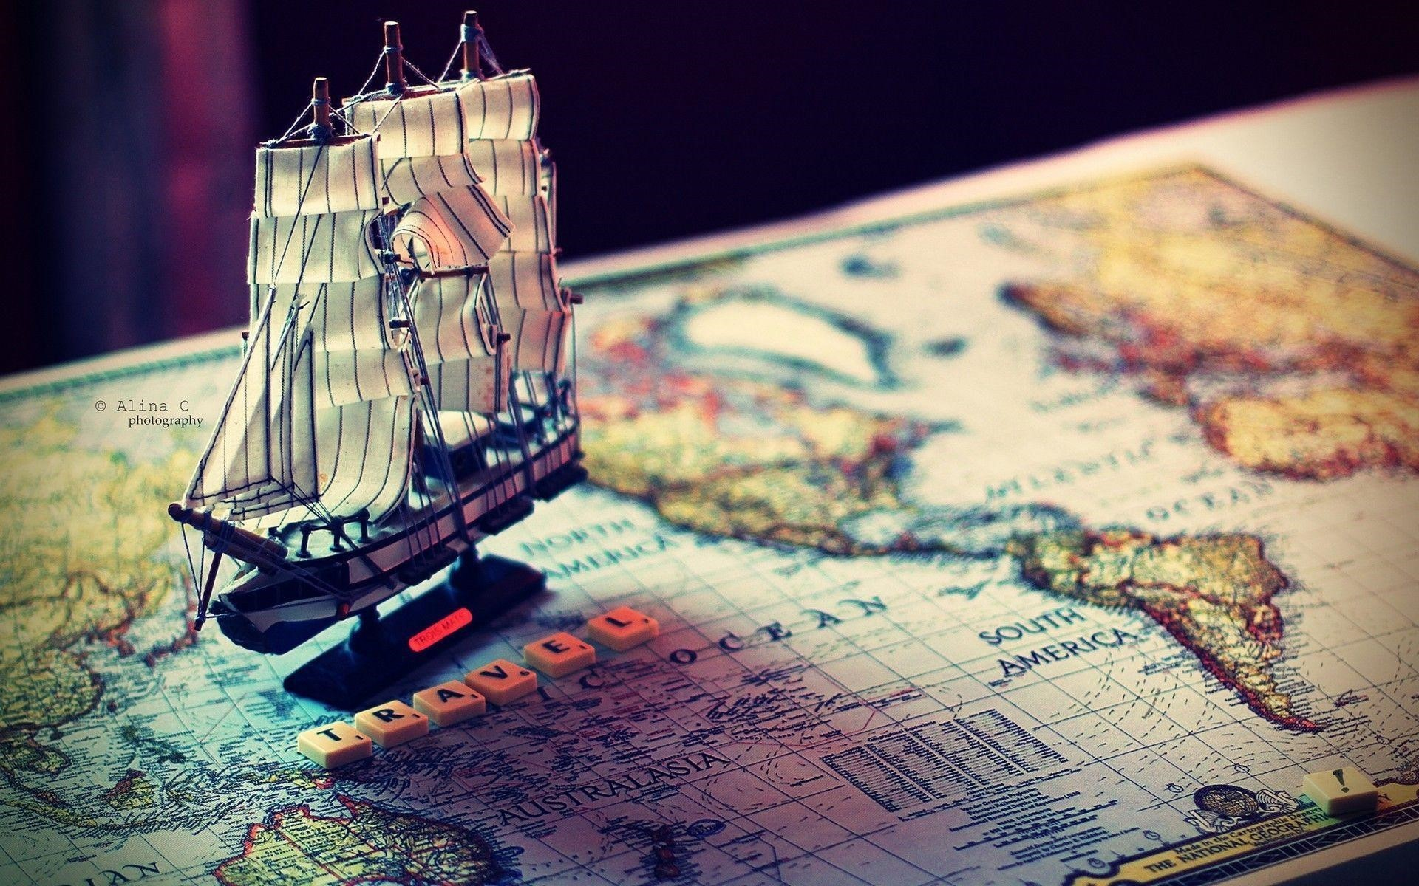
The comments or what a user thinks about the place just sticks to private conversations or in heart so by revealing the deeper thoughts of users, will help to get application more data.
The modern era is going on and collection of huge data is becoming easier day by day so, sitting on a couch, got an idea to also get help from people to collect information of places.
YouTube and other social platforms are being used to earn by making Vlogs, it is a new form of Blogs that was flourished in 1997, using that thing information about places can be gained with more fun and also users may enjoy this.
Music, after getting 900+ views on RAP GOD, meaning - live concerts will be a better interest for users also exhibitions and other events can be used in the same manner.
How we do it?

Slide 8

Technology
Used

Slide 9
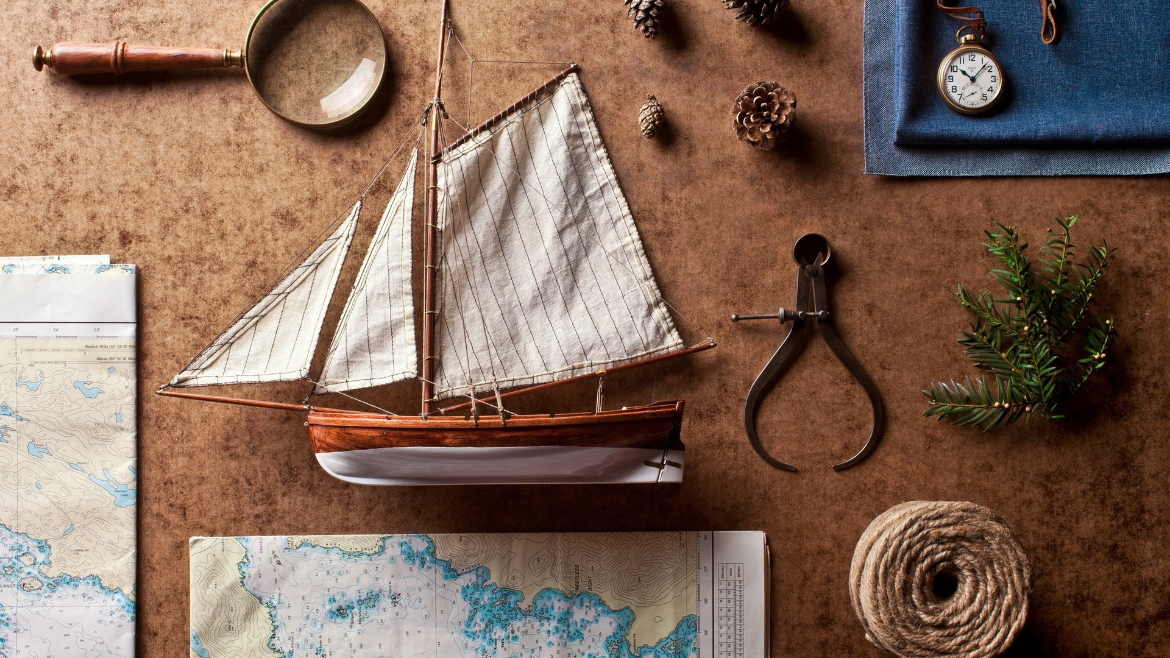


TEAM
M. Jazzel Mehmood
Project Leader
Web + Android Developer
Muhammad Bilal
Web Designer + Web Developer
Mubashir Imtiaz
Web Designer + Web Developer

Slide 10
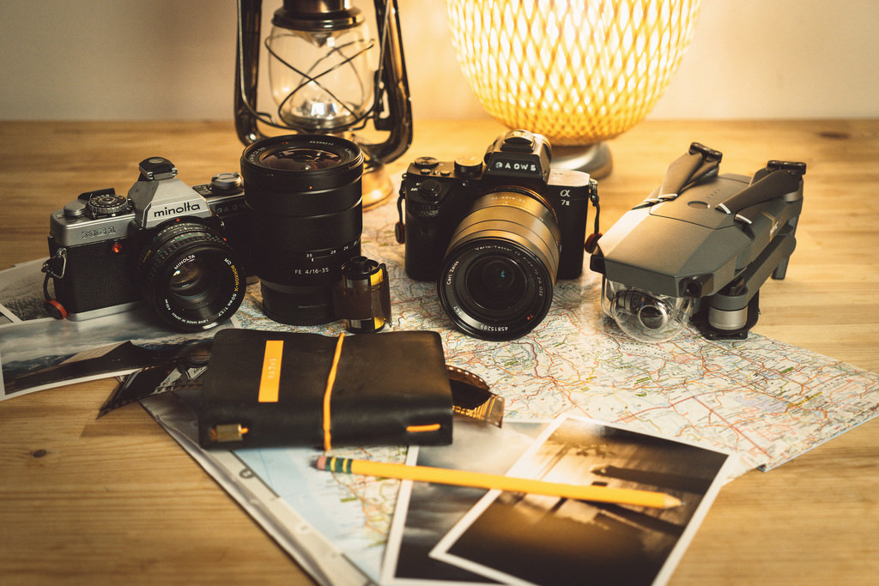
MARKETING PLAN
Social Networks
Travelling Destinations
Hotels & Resorts
Partnerships

Slide 12

Thanks !!
Any questions ?
You can find us at:
travellingdiaries2019@gmail.com

